Slide 1
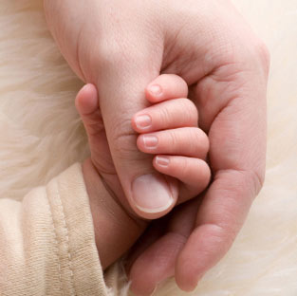

FASCIAL SPACES OF FOREARM AND HAND
DR A K SRIVASTAVA
PROF. AND HEAD
DEPARTMENT OF ANATOMY
17-10-14

Slide 2
Arrangement of the fascia and fascial septae in the hand is such that they form many spaces.
Fascial spaces of the palm are potential spaces filled with loose connective tissue.
Spaces are of surgical importance because they may become infected and distended with pus.
Their boundaries are important clinically because they may limit the spread of infection in the palm.

Slide 3
Spaces Of Forearm & Hand
FOREARM SPACE OF PARONA
PALMAR SPACES
  Thenar space
  Midpalmar space
  Web space
DORSAL SPACES OF HAND
Dorsal subcutaneous space
Dorsal subaponeurotic space
SUPERFICIAL PULP SPACE OF FINGERS

Slide 4
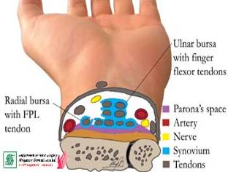
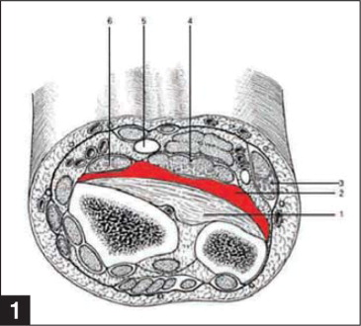
FOREARM SPACE OF PARONA
Location
Boundaries
The space of Parona and its boundaries.
1 Pronator quadratus;
2 Space of Parona;
3 Flexor carpi ulnaris;
4 Flexor digitorum profundus;
5 Median nerve;
6 Flexor pollicis longus.

Slide 5
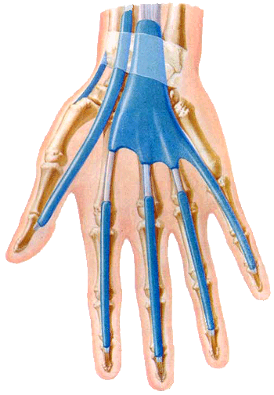
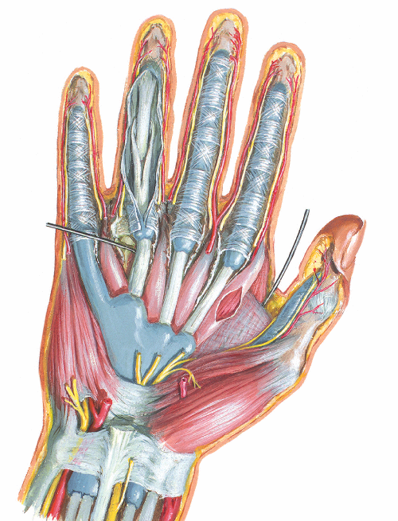
RADIAL & ULNAR BURSAE

Slide 6
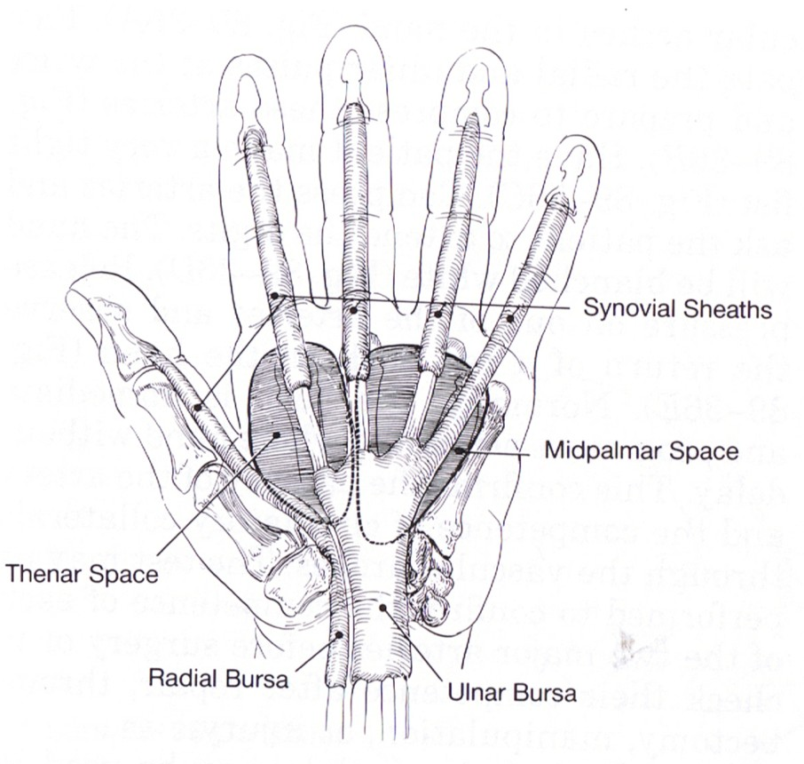
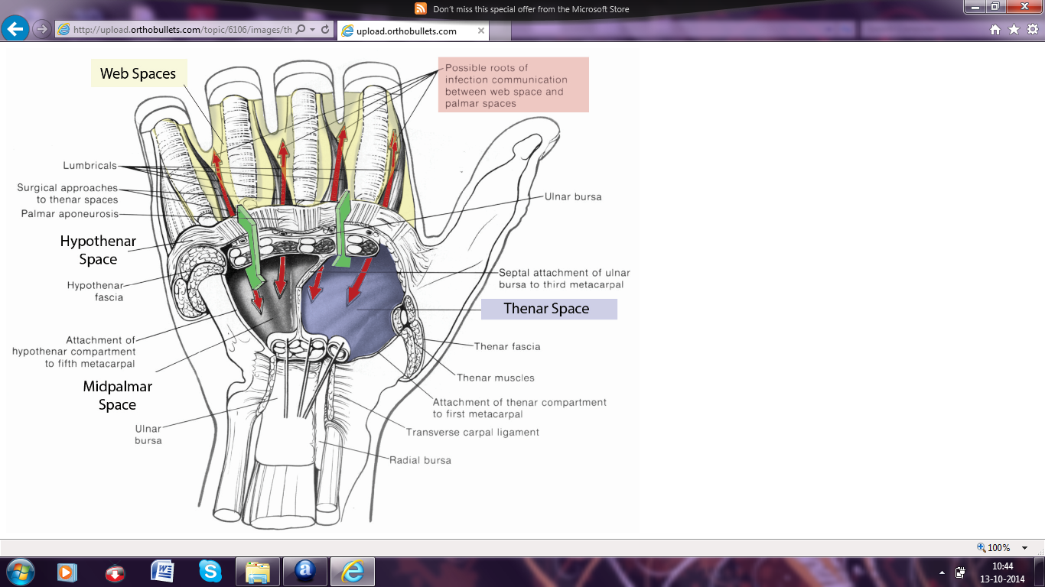
PALMAR SPACES
  Thenar space
  Midpalmar space
  Web spaces
Distally - the thenar & midpalmar spaces are continuous with the appropriate lumbrical canals

Slide 7
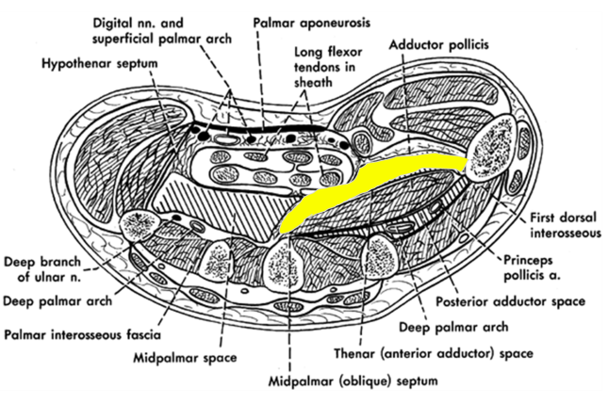
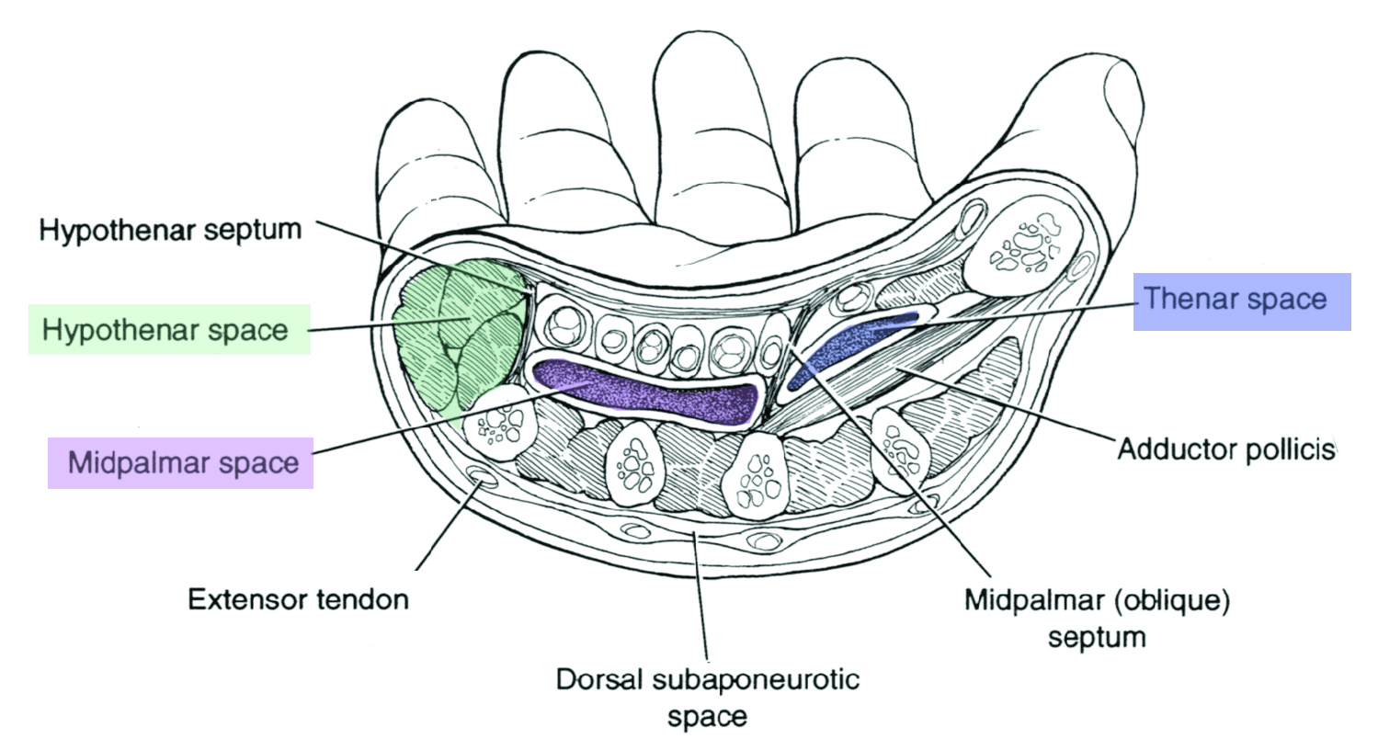
  Thenar Space
Location
Boundaries
The thenar space contains the first lumbrical muscle and lies posterior to the long flexor tendons to the index finger and in front of the adductor pollicis muscle

Slide 8
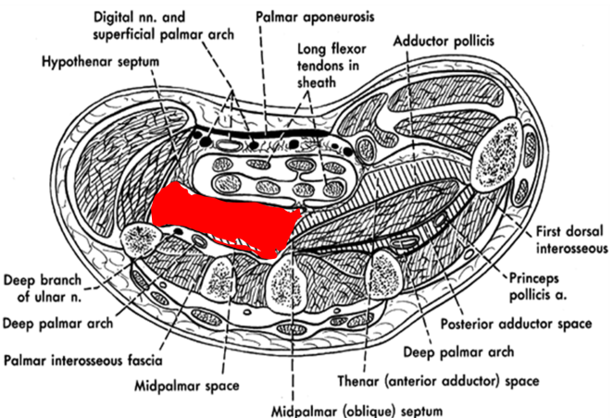
  Midpalmar Space
Location
Boundaries
Anterior - the long flexor tendons to the middle, ring, and little fingers.
Posterior - interossei and the third, fourth, and fifth metacarpal bones

Slide 9
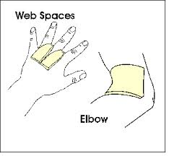
  Web Spaces
potential spaces surrounding the tendon of each lumbrical muscle, normally filled with connective tissue.
Three in number
They lie between the index, middle, ring, and little finger
Proximally continuous with one of the palmar spaces.

Slide 10
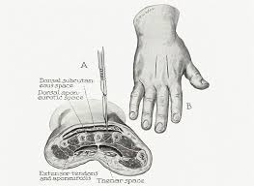
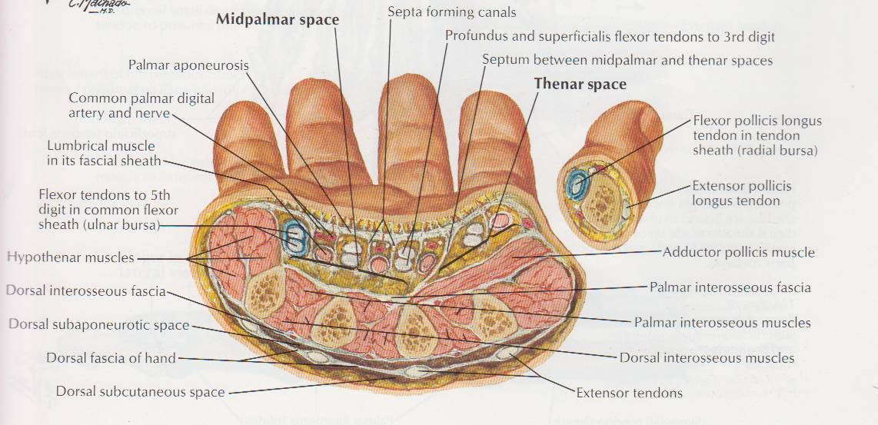
DORSAL SPACES
Dorsal subcutaneous space
Dorsal subaponeurotic space

Slide 11
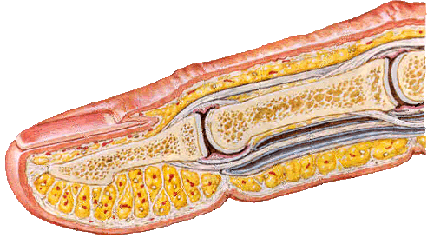
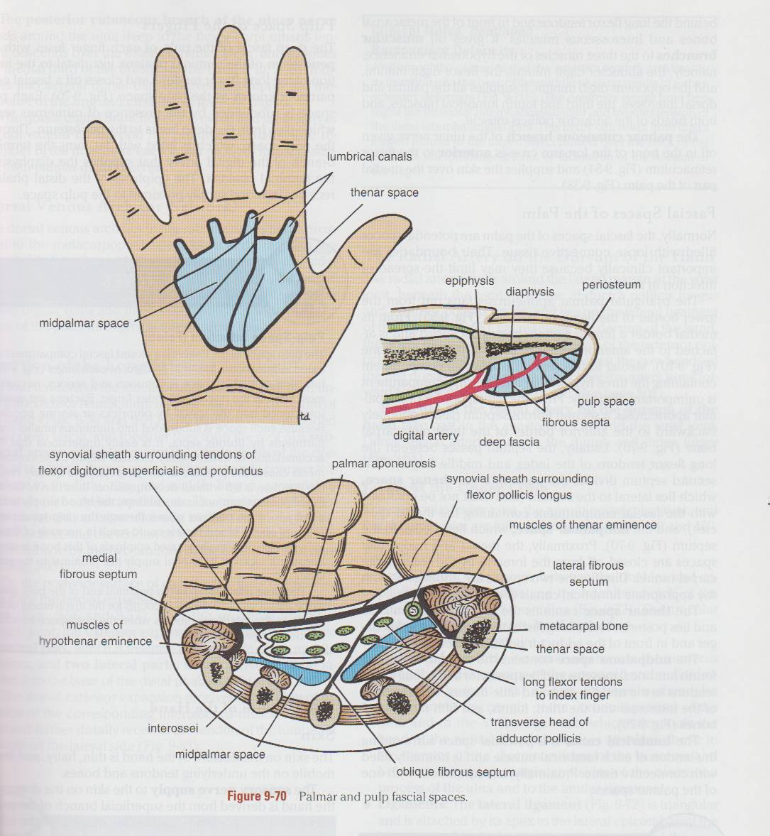
SUPERFICIAL PULP SPACE OF FINGERS
Each pulp space filled with fat is subdivided by the presence of numerous septa
Through pulp space runs the terminal branch of the digital artery that supplying the diaphysis of the terminal phalanx.
The epiphysis of the distal phalanx receives its blood supply proximal to the pulp space.

Slide 12
Applied anatomy

Slide 13
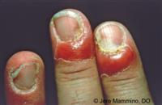
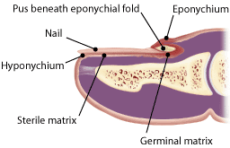
Paronychia
Infection along lateral nail fold.
Follows trauma of nail bed.

Slide 14
Paronychial Drainage

Slide 15
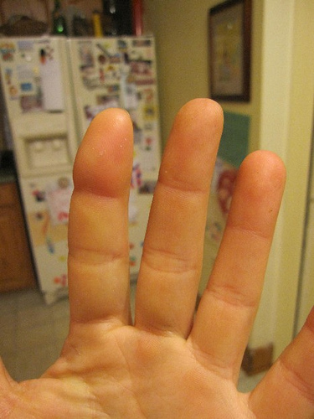
Felon (Pulp-Space Infection)
Subcutaneous abscess in pulp space of finger.
Pressure on the blood vessels could result in necrosis of the diaphysis.
Epiphysis of this bone is saved because it receives its arterial supply just proximal to the pulp space.

Slide 16
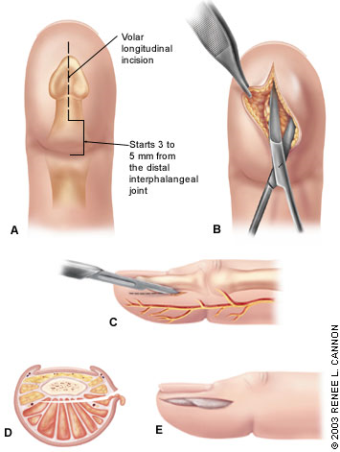
SURGICAL TREATMENT
Longitudinal volar incision
Unilateral longitudinal incision
Bilateral longitudinal incision

Slide 17
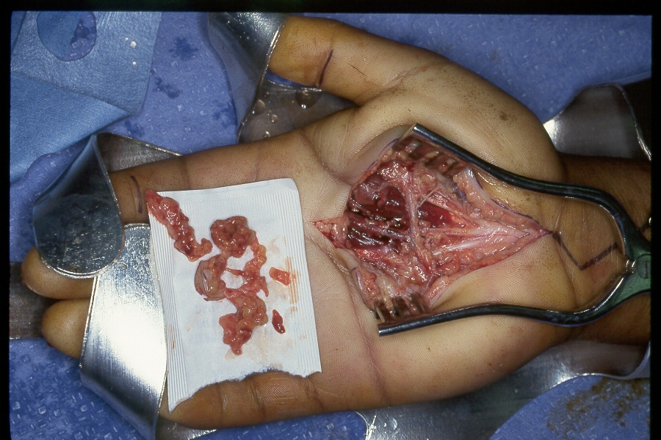
Infection Of Medial Palmar Space
Infection reaches from a lumbrical canal or infected tendon sheath.

Slide 18
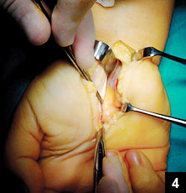
Infection Of Thenar Space
Lies under palmar fascia.
Bounded dorsally by transverse head of adductor pollicis.

Slide 19
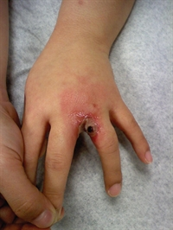
Web Space Infection
Most common site after involvement of pulp spaces.
Pus mostly gathers near palmar space but may spread.

Slide 20
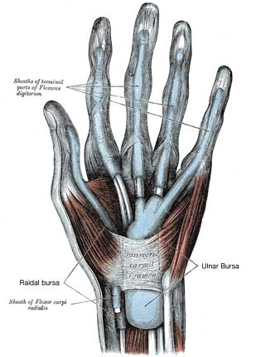
Infection Of Radial 0r Ulnar Bursa
May spread to radial bursa.

Slide 21
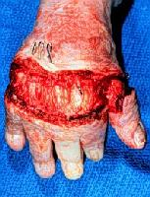
Infection Of Dorsum Of Hand
Dorsum swells but pus seldom collects.
If pus collects it is subcutaneous.

Slide 22
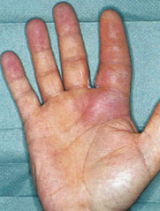
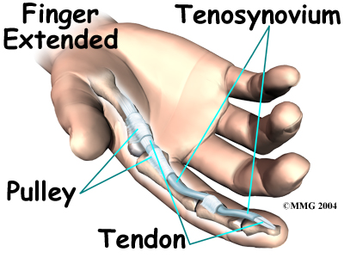
Pyogenic Flexor Tenosynovitis
Closed space infection in of flexor tendon sheath of digit.
Results from penetrating trauma or hematogenous spreading.

Slide 23
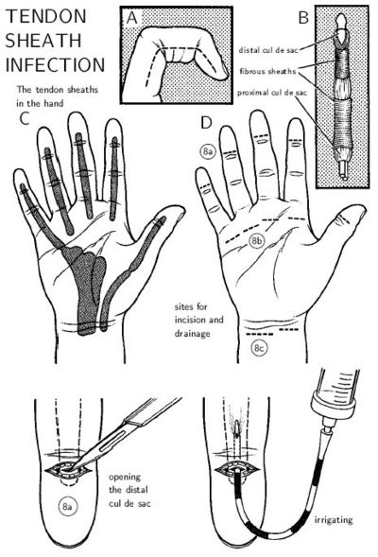
SURGICAL TREATMENT
Two methods:
Closed irrigation- 2 incisions
Proximal
Distal
Open drainage and debridement- 2 incisions
1st- Over pulley.
2nd – Over digit.

Slide 24
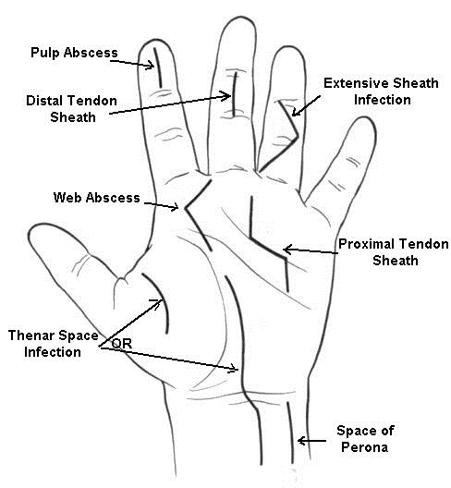
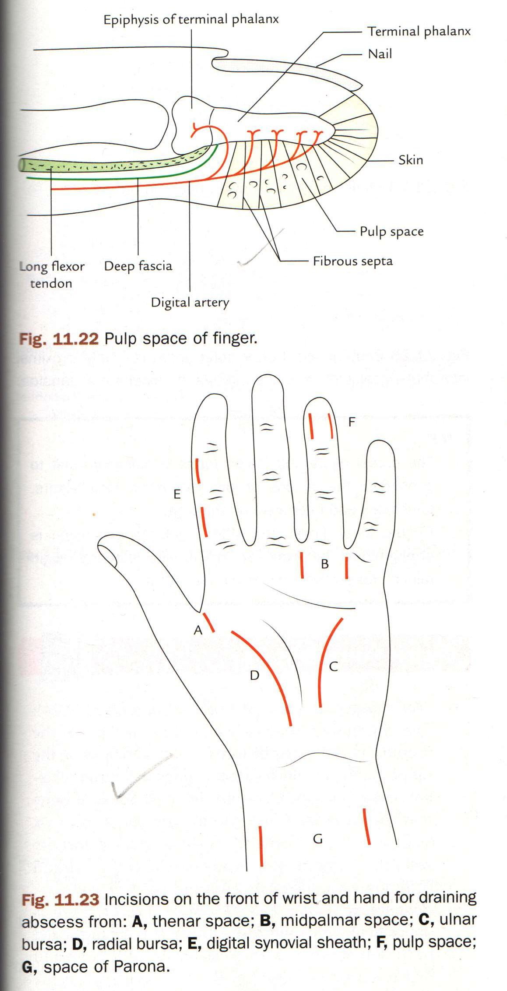
Incisions for drainage of abscess

Slide 25
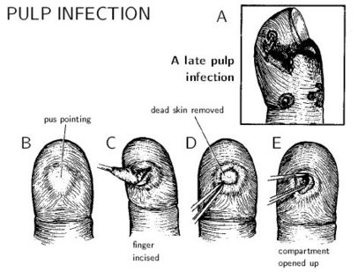
Infection Of Pulp Spaces
Most common hand infection
Fibrous compartments cause throbbing pain.

Slide 26
MULTIPLE CHOICE
QUESTIONS

Slide 27
Question 1
Which of the following is NOT a palmar fascial space
  1. Thenar space
  2. Midpalmar space
  3. Space of Parona
  4. Web space

Slide 28
Question 2
The digital synovial sheath of which finger communicates with the ulnar bursa
  1. Index finger
  2. Middle finger
  3. Ring finger
  4. Little finger

Slide 29
Question 3
Which of the following is a content of the Thenar space?
  1. Tendon of flexor carpi radialis
  2. Tendon of flexor carpi ulnaris
  3. Tendon of flexor pollicis longus
  4. Tendon of flexor digitorum superficialis for middle finger

Slide 30
QUESTION 4
The posterior boundary of the midpalmar space is formed by all EXCEPT
  1. Palmar interossei
  2. Dorsal interossei
  3. Lumbricals
  4. Fascia covering medial part of transverse head of adductor pollicis

Slide 31
Question 5
All of the following statements about the pulp space are true EXCEPT
  1. Present at the finger tips
  2. Fat present in loculated compartments
  3. Infection may cause necrosis of diaphysis in children
  4. Pulp space infections are usually painless

Slide 32
THANK YOU

